Slide 1
University of Gujrat Department of Computer Science
Course Code : CS-252
Computer Organization and Assembly Language
Lecture # 2
Basic Computer Organization

Slide 2
Basic Computer Organization
A computer system comprises of Processor, Memory and I/O devices.
I/O is used for interfacing with the external world, while memory is the processor’s internal world.
Processor is the core component and is responsible for performing operations.
Memory
Processor
I/O
I/O

Slide 3
Interconnection between Components

Slide 4
Interconnection between Components
The processor performs an operation on data, which resides in memory.
A mechanism is required for the processor to read data from the memory.
Processor
Operation
Memory Data
Memory Data

Slide 5
Address, Data and Control Buses
There must be a mechanism to inform memory that we want to do the read operation
Control Bus
There must be a mechanism to inform memory that we want to read precisely which element
Address Bus
There must be a mechanism to transfer that data element from memory to processor
Data Bus

Slide 6
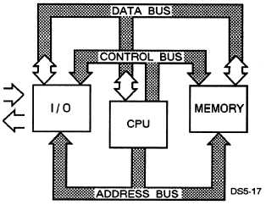
Bus
The process may be able to communicate with all the devices. The devices are connected together by communication channel called a BUS.
A bus is composed of a set of communication lines or wires.
It is used to move large amount of bits in form of electrical pulses from a specified source to a specified destination.

Slide 7
Control, Address and Data Buses
The group of lines that carry control information from the control unit to the other units is the Control Bus
The group of lines that carries the address information is the Address Bus
The group of wires or lines that moves data between the different components is the Data Bus
For e.g.
If the processor wants to read data from the address ‘135Fh’ of memory
Processor
135Fh
Memory
Address Bus
2
Data Bus
Read
Control Bus

Slide 8
Control, Address and Data Buses
Processor
Address Bus
Memory
Data Bus
Control Bus

Slide 9
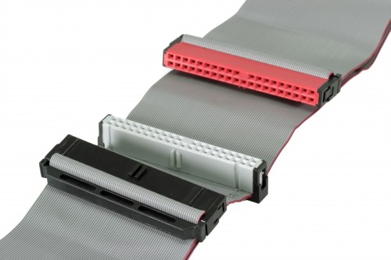
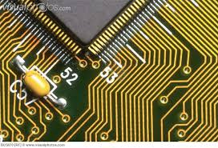
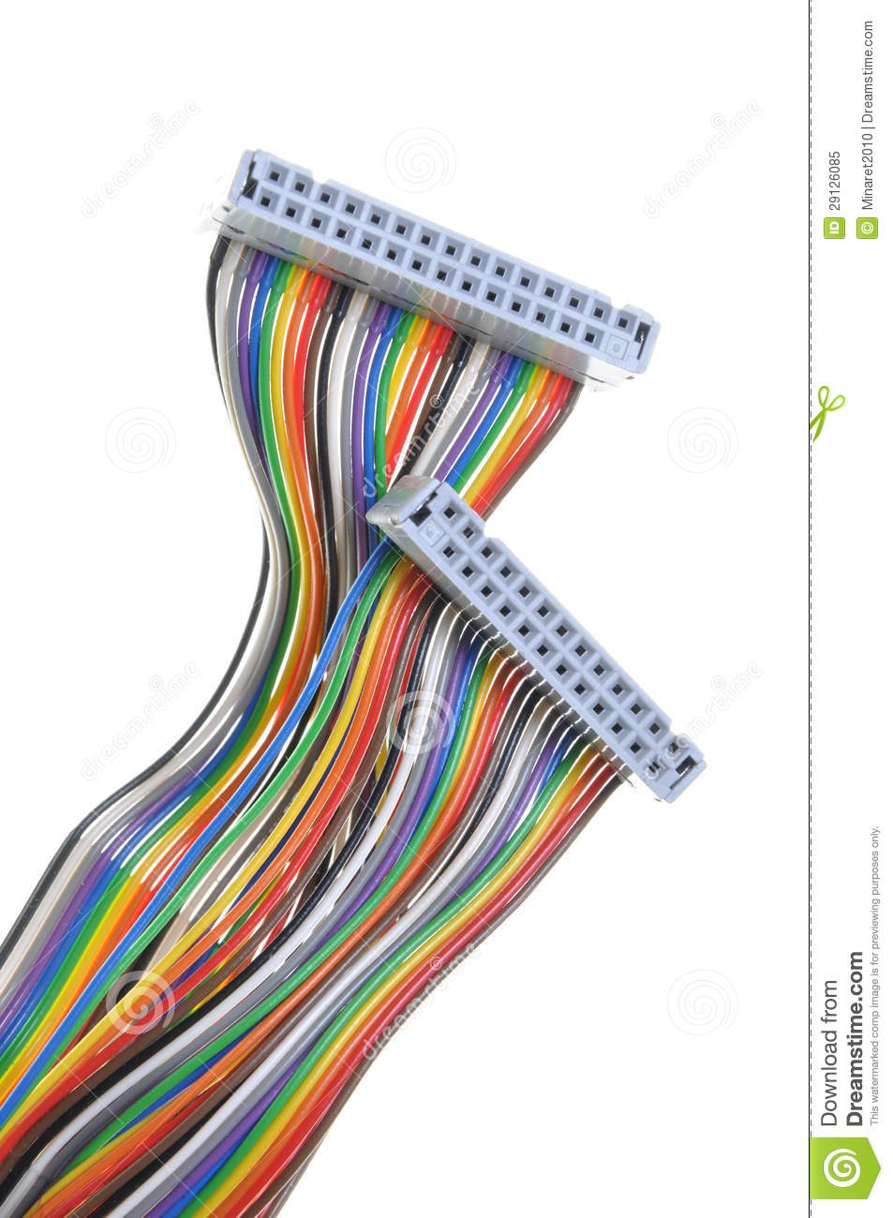
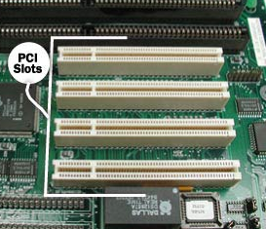
What do buses look like?
Parallel lines on circuit boards
Ribbon cables
Strip connectors on mother boards
e.g. PCI
Set of wires
Fig. Parallel lines
Fig. Ribbon Cables
Fig. connectors
Fig. Set of wires

Slide 10
Basic Memory Organization
Information processed by a computer is stored in its memory.

Slide 11
Memory Byte
Memory circuit element can store one bit of data.
Memory circuits are organized into groups that can store 8 bits of data called Memory Byte.
Each memory byte is identified a number that is called its Address.
Contents of Memory Byte are always 8 bits but the number of bits in an address depends upon the processor.
For e.g.
Intel 8086 microprocessor assigns a 20-bit address
Address
Contents
4
01011011
3
11001001
2
01011011
1
01000010
0
00011000

Slide 12
Memory Word
Memory Word is any pair of successive memory bytes treated as a single unit
The lower address is used as the address of the memory word.
3
01000010
2
00011000
Address
Memory Word

Slide 13
Bit Position in a Byte and a Word
Byte
bit position
7 6 5 4 3 2 1 0
High Byte
Low Byte
Word
bit position
15 14 13 12 11 10 9 8 7 6 5 4 3 2 1 0

Slide 14
Memory Operations
The processor can perform following two operation on memory:
Read ( fetch the contents of a location )
Write ( store data at a location )

Slide 15
RAM and ROM
There are two kinds of memory circuits:
Random Access Memory (RAM)
Read Only Memory (ROM)
RAM
RAM locations can be Read and Written
Volatile
Programs instructions and data are normally loaded into RAM
ROM
ROM location can only be Read
Non-Volatile
Used by manufactures to store system programs. ROM based programs are known as Firmware

Slide 16
CPU Organization

Slide 17
CPU
Brain of the computer
Controls the computer by executing programs stored in memory
Each instruction executed by it, is a bit string
Instructions performed by a CPU is called the Instruction Set. Instruction set for each CPU is unique.
There are two functional units:
Execution Unit (EU)
Bus Interface Unit (BIU)

Slide 18
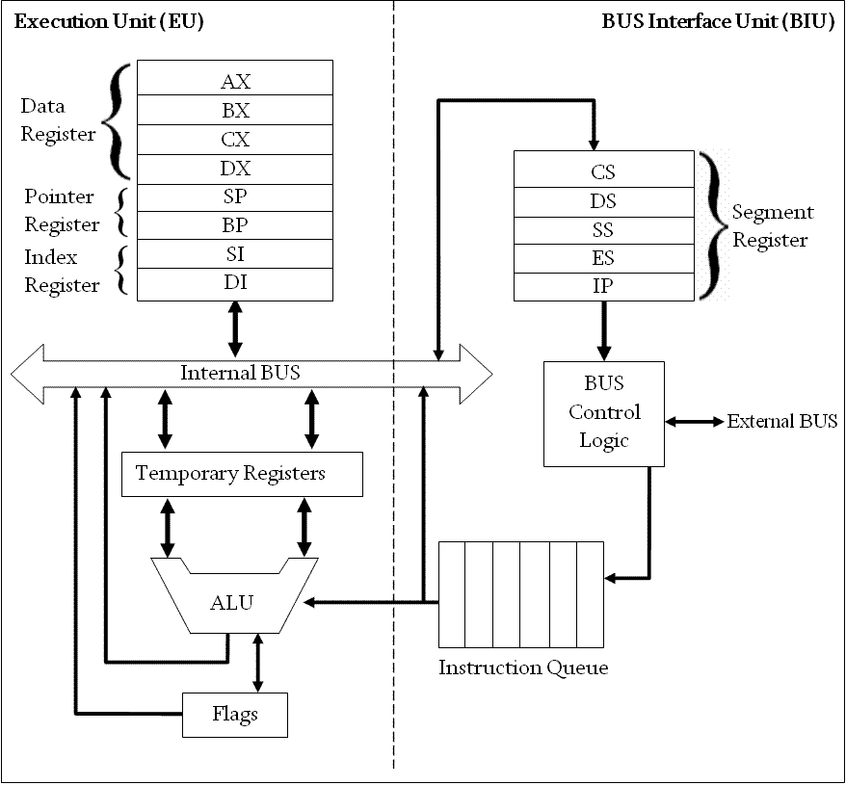
Intel 8086 Micro Processor Organization

Slide 19
Execution Unit (EU)
Executes instructions
Contains circuits called Arithmetic and Logic Unit
Contains 8 registers for storing data
AX, BX, CX, DX, SI, DI, BP and SP
Contains temporary registers for holding operands for the ALU
FLAG registers whose individual bits reflect the result of a computation

Slide 20
Bus Interface Unit (BIU)
Facilitates communication between the EU and the memory or I/O circuits
Contains registers CS, DS, ES, SS and IP for holding addresses of memory locations
EU and BIU connected by an Internal Bus
While EU is executing an instruction. BIU fetches next instruction and places it in the instruction queue, this is called instruction prefetch

Slide 21
Instruction Execution Cycle
(Fetch-Execute Cycle)

Slide 22
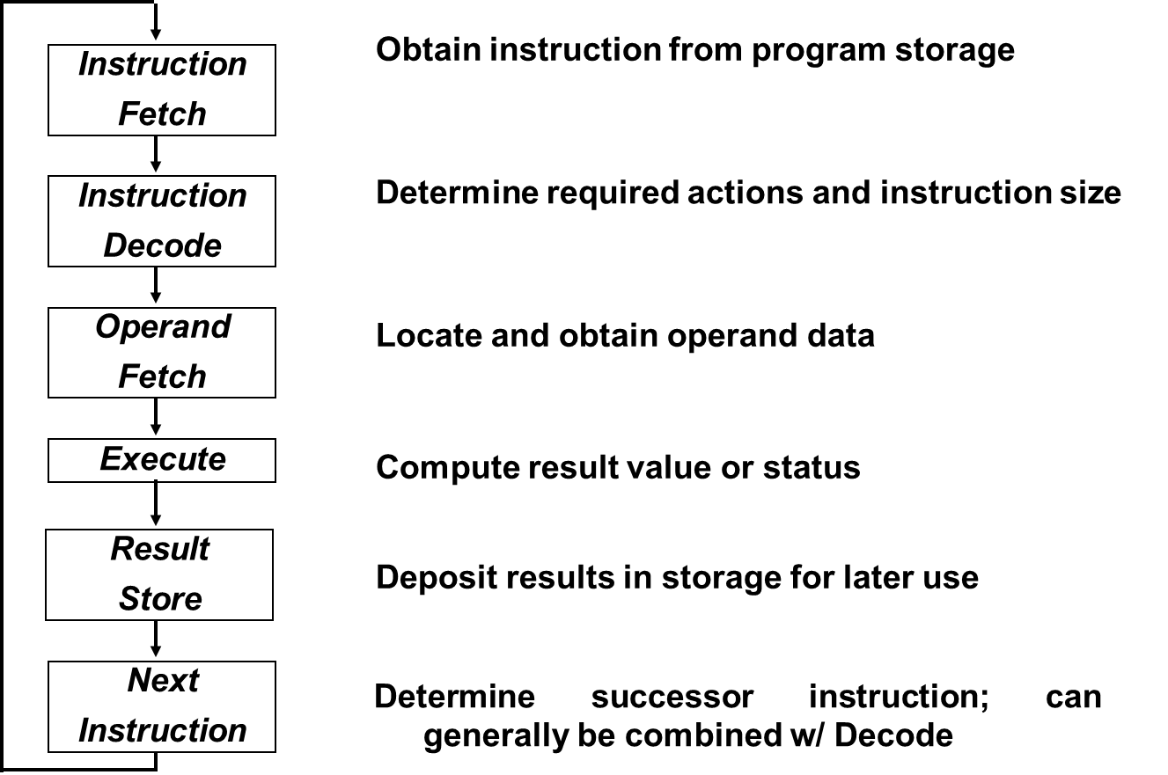
Fetch-Execute Cycle
Fetch
Execute

Slide 23
THE END
-------------------------------------------------------------------------------------------------------------------------

